Slide 1
Movie Recommendation System
Deepesh Kumar Verma
Ankita Purohit
Pasala Nuthan Vara Kishore
Ajinkya Eknath Marathe
Rajratna J Dubdube
Tirumala Shrikanth
Tushar Yashwant Pansare
“Invigilator”- Iftekar patel
Group : P300 - 4

Slide 2

Recommendation System
Recommendation system produce a ranked list of items on which a user might be interested in the context of his current choice of an item.
Recommendation system has mainly two elements item and user.

Slide 3
Reason to create this recommendation system!
The majority of people watch movies in today's culture, but they are only allowed to watch one before they feel confused about what to watch next. What if there was a system that could comprehend you and provide recommendations for you based on your interests? Recommendation systems are there to help with it.
Customers frequently check at the product recommendations from their most recent browsing. Customer happiness is the most crucial factor, and the recommendation system has been helping with that for years.
User-specific recommendations are provided by recommender systems, which also assist users in making informed choices during online transactions. Sales are increased, the web surfing experience is changed, customers are retained, and the shopping experience is improved.

Slide 4
Business Objective:
Scrape Movie dataset from IMDB website, perform analysis for deeper insights and build an recommendation system.
Dataset Details:
The data set contains of top 10000 movies which we have scraped the data from the IMDB website.
It consist of Genre, Rating, Description, Cast, Director, Gross, Meta Score, Votes, Runtime, Certificate, Year, Name.

Slide 5
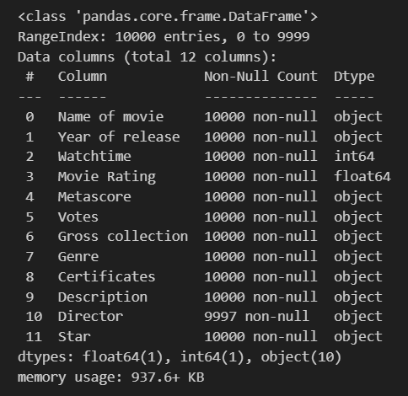
Variables
The Data consists of 10000 non null entries.
There are a total of 12 columns.
All the variables consist of same entries except the director column.
The data type of all the variables are shown perfectly.

Slide 6
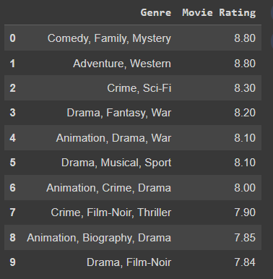
Average Ratings by Genre

Slide 7
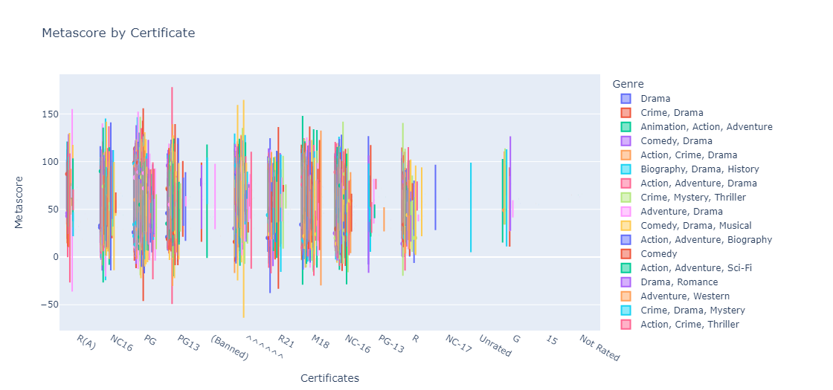
Metascore by Certificate

Slide 8
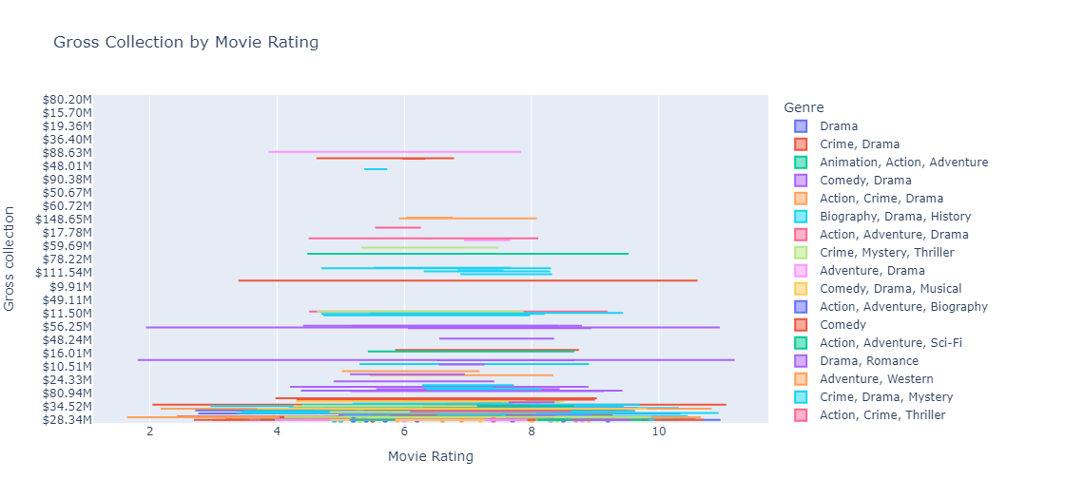
Gross Collection by Movie Rating

Slide 9
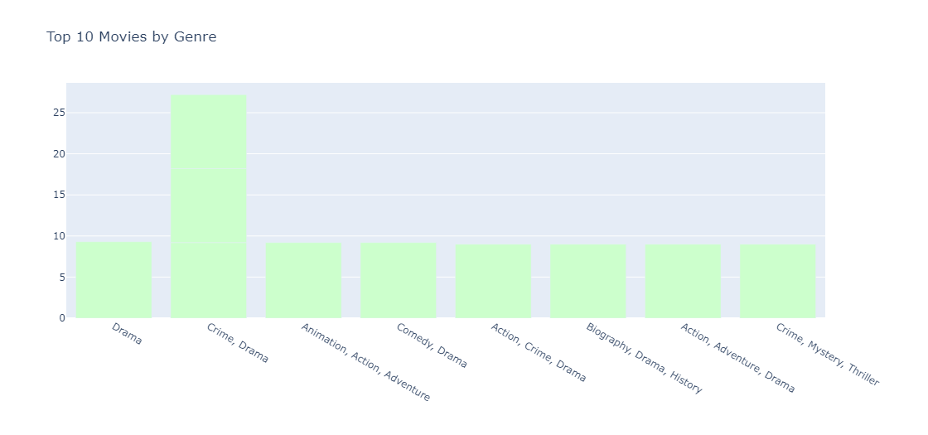
Top 10 Movies by Genre

Slide 10
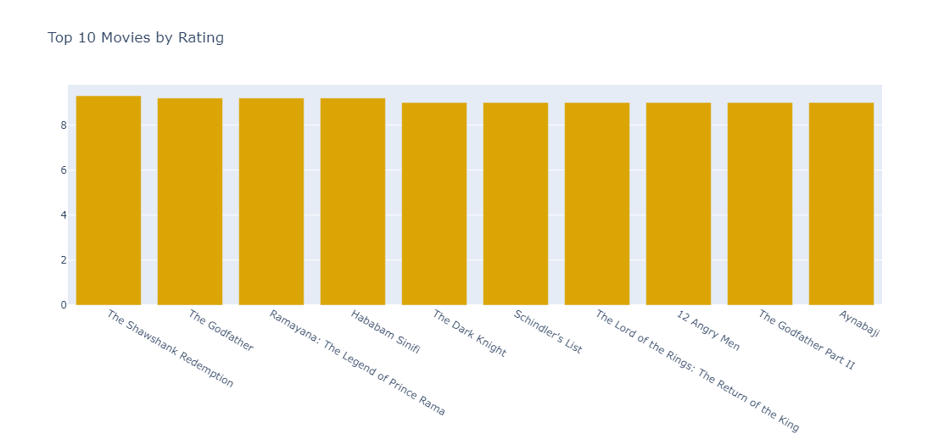
Top 10 Movies by Rating

Slide 11
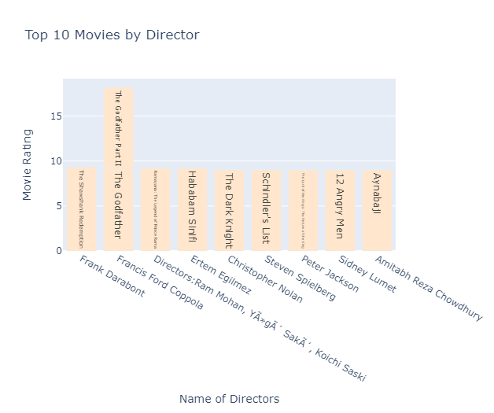
Top 10 Movie Directors

Slide 12
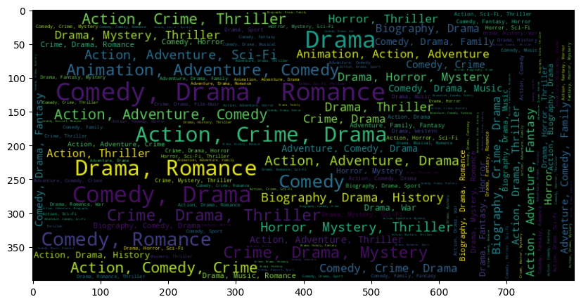
WordCloud by Genre

Slide 13
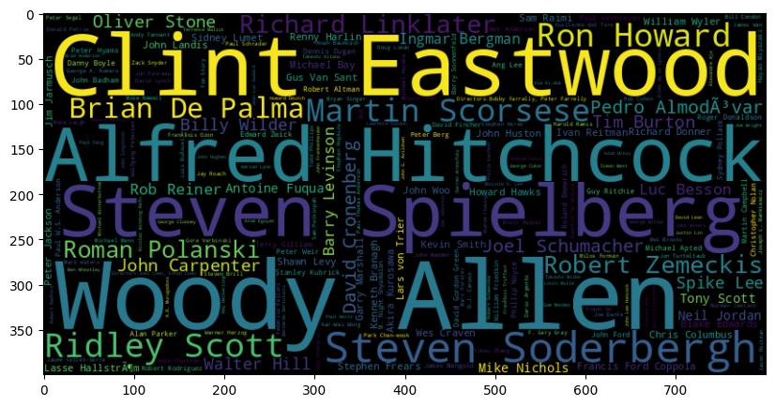
WordCloud by Director

Slide 14
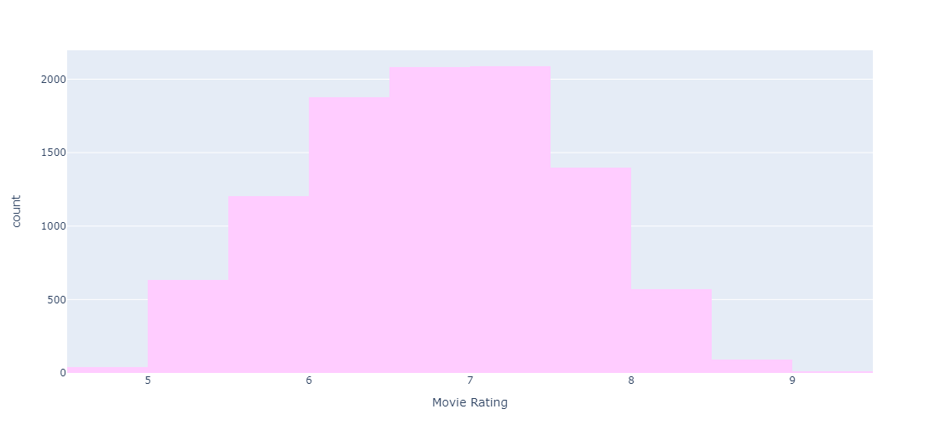
Movie Rating

Slide 15
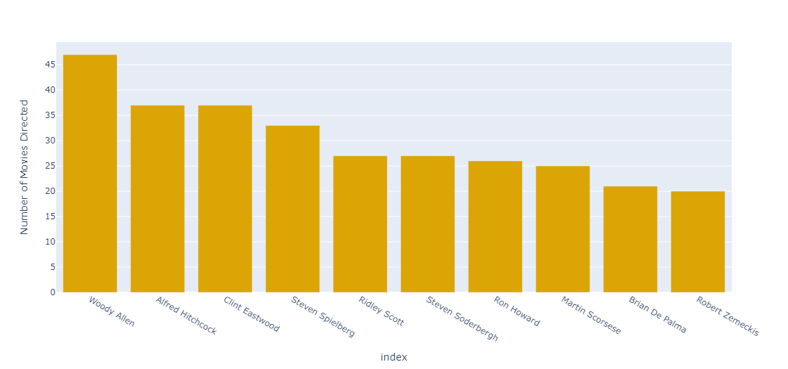
Which director has the most movies on the Top 1000 list?

Slide 16
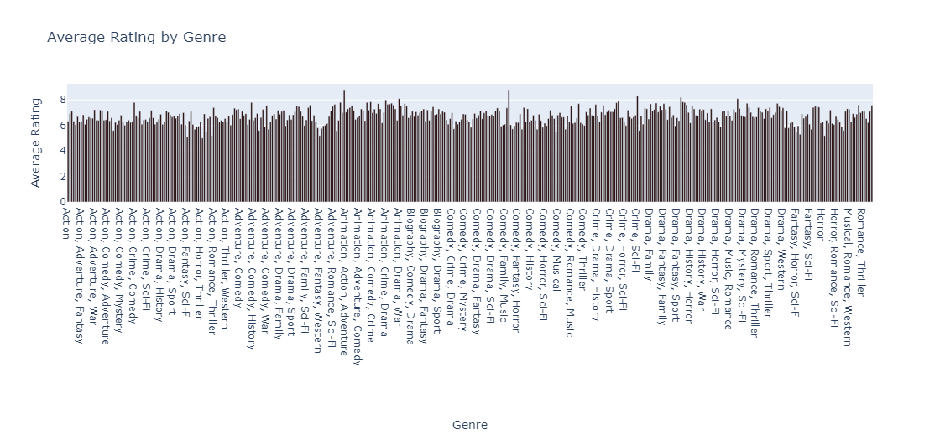
Which Genre has the highest average rating?

Slide 17
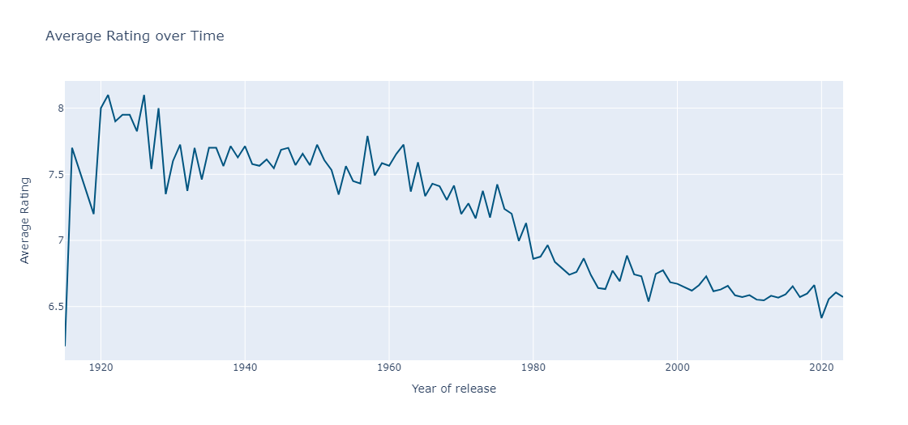
Average Rating over Time

Slide 18
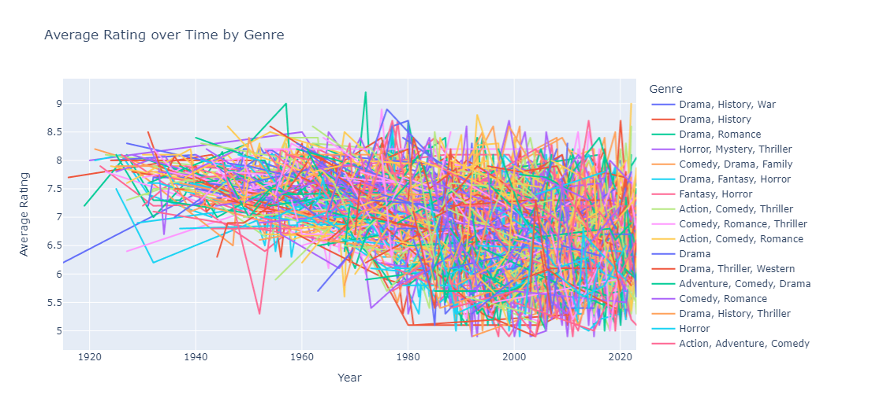
Average Rating over Time by Genre

Slide 19
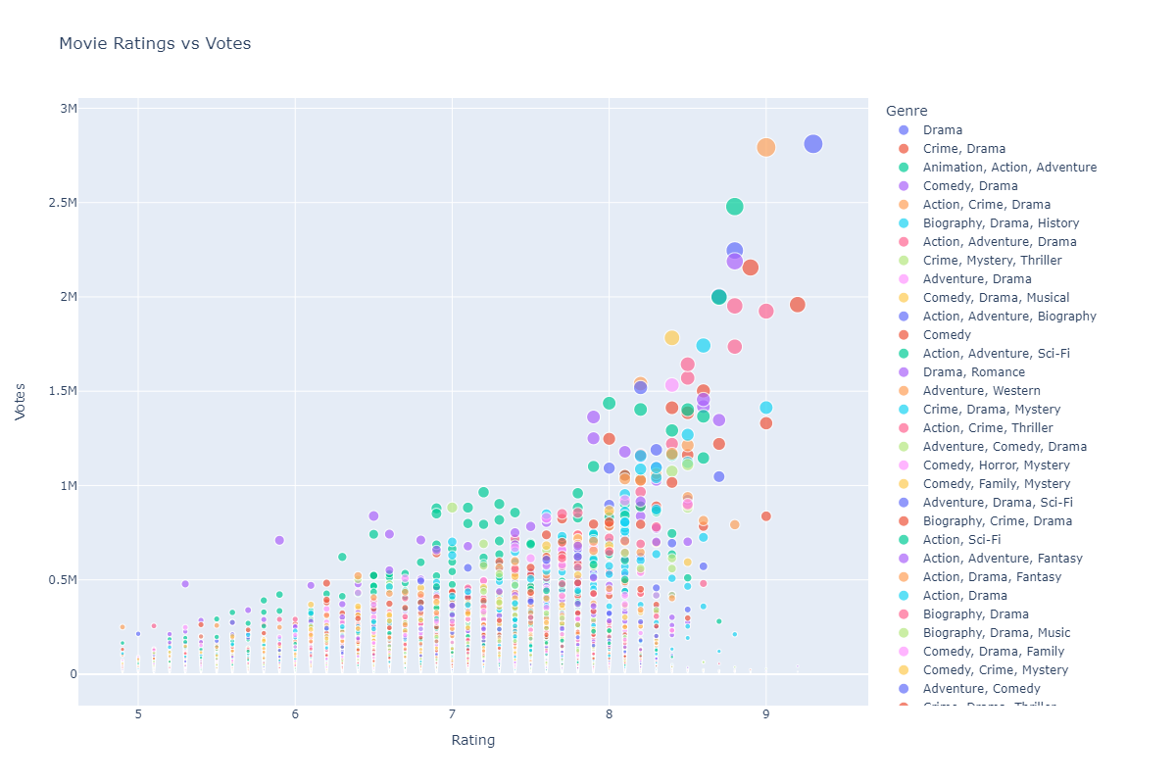
Movie Ratings vs Votes

Slide 20
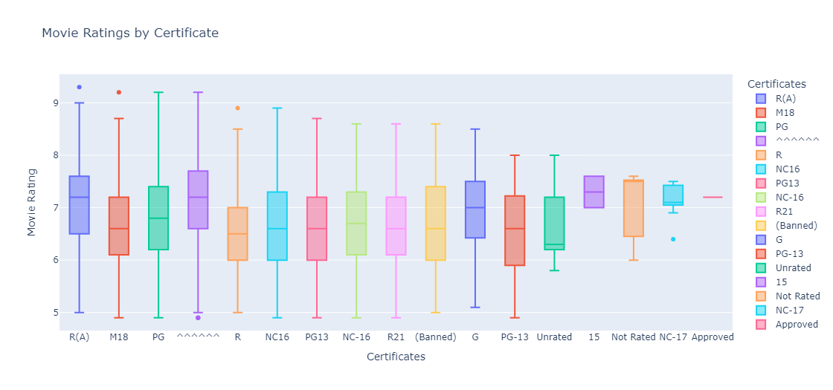
Movie Ratings by Certificate

Slide 21
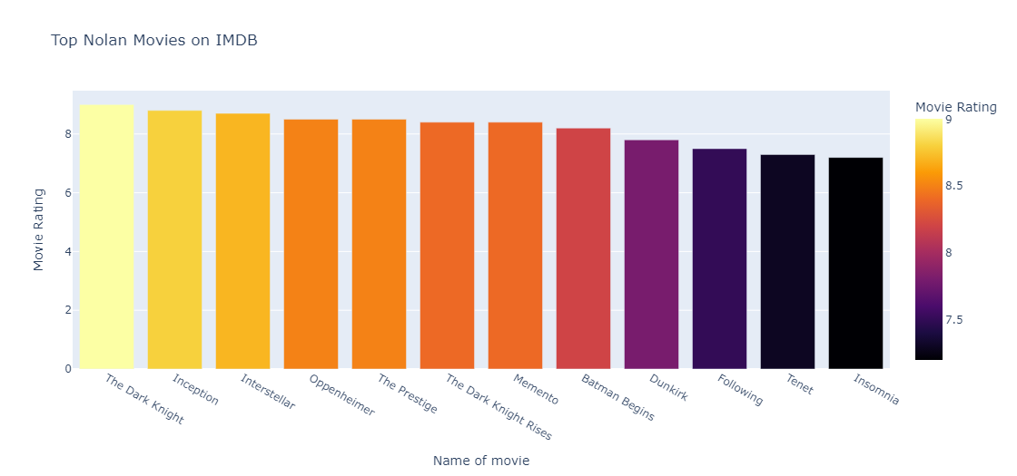
Top Nolan Movies on IMDB

Slide 22
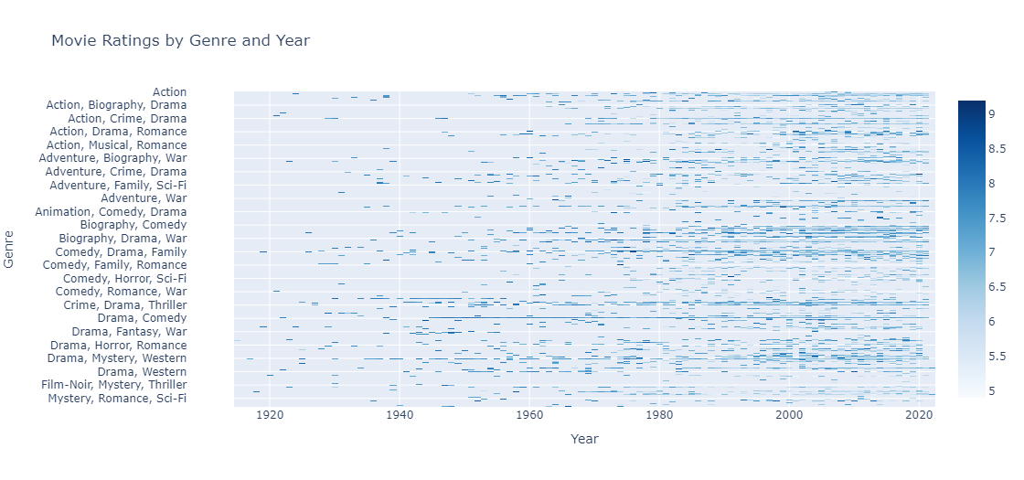
Movie Ratings by Genre and Year

Slide 23
Cosine Similarity
The cosine similarity is the simplest algorithm needed to find the similarity of the vectors. In cosine similarity, data objects in a dataset are treated as a vector. The formula to find the cosine similarity between two vectors is –
Cos(x, y) = x.y / ||x|| * ||y||
The cosine similarity is useful because even though the two comparable papers are far away by the Euclidean distance chances are, they may still be orientated closer together. The lesser the angle, higher the cosine similarity.

Slide 24
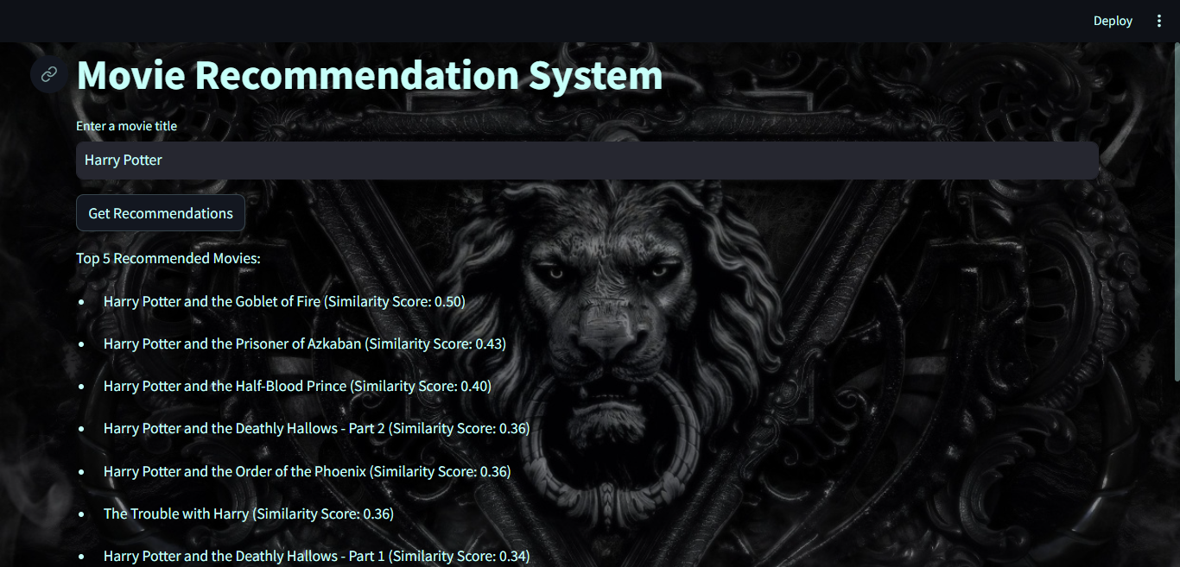

Slide 25
Conclusion
Movie recommendation systems benefit users and businesses.
Movie recommendation systems save users time and help underappreciated films succeed.
Clustering algorithms and hybrid approaches can address sparsity in collaborative filtering.

Slide 26
Thank You

